Slide 1
Rating prediction
By –SHARUKH ANSARI

Slide 2
Problem Statement
In this project we need to build a model which can Predict the rating of a reviews
Now a days people like to purchases product online. But before purchasing any product people like to see reviews and Rating of that Product.
So, we work on a project to build a model to predict Rating of a comment passed through it.

Slide 3
Data Collecting
Data Scrapping:
We need to collect the data before building this model.
I have scrapped the data from the ecommerce site( Flipkart and Amazon). But most of the reviews are from Flipkart
After collecting data from both the ecommerce giants. Genarate Dataframe and save data.

Slide 4
Analysis
Data :
We need to clean data before building any model.
Removing punctuation, stop word and other pattern which do not hold any importance or meaning in documents
We need to check what words people frequently while posting comments.

Slide 5
Understanding
The data set contains approximately 20,067 samples contain 3 fields which includes ‘Rating’, ‘Full_Review’, ‘Short Reviews’.
There are some ecommerce sites which needs a model which can predict the rating of the comment.
Our goal is to build a prototype of online Rating classifier which can used to classify Rating.

Slide 6
Exploratory data analysis
Importing the dataset:
Importing the dataset using the “read_csv()” function of the Pandas library. This function can read a CSV file (either locally or through a URL) and also perform various operations on it.
df = pd.read_csv(“Flipkart(in csv).csv")
Extracting the independent variable.
To extract the independent variables, we used drop function of the Pandas library.
X = Features
Here data_training is the data set which contains the independent and dependent variable i.e comment text and target column which is created by us.

Slide 7
Exploratory data analysis
Dataset cleaning
In this dataset we need to first clean all the documents so that we can reduce the size of the no. of features and make our data more clean and understandable.
To clean the dataset we have used regex exp to remove punctuation, numbers, email id, and extra spaces between words but before removing any of this we need to convert all the documents into lower case
Stop words:- Stop words are those words which is present frequently but do not carry any information or importance so we also need to remove this from documents.
After cleaning the dataset we need to convert comments into vectors. I have used TF-IDF to convert comments into Vectors
Splitting the data:
x_train,x_test,y_train,y_test = train_test_split(X,Y,test_size = .25,random_state = 0)

Slide 8
Visualization

Slide 9
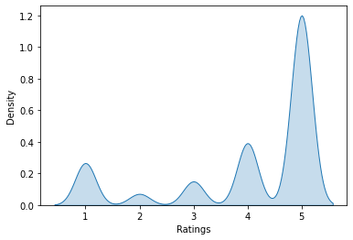
Target distribution

Slide 10
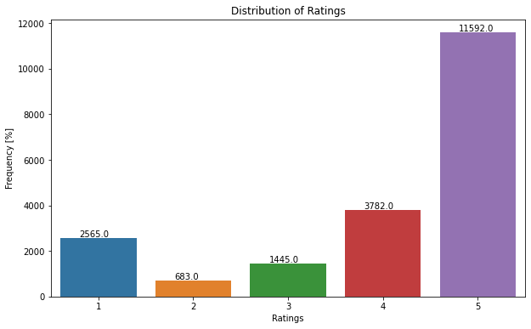
Target distribution

Slide 11
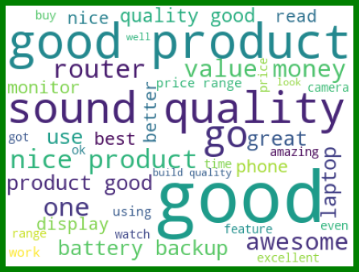
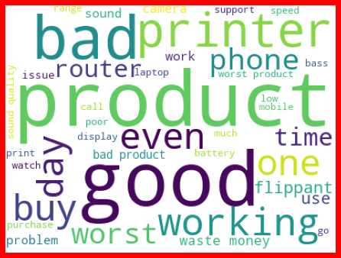
Full Reviews Wordcloud
Frequents words used in ratings 3 and above
Frequents words used in ratings below 3

Slide 12

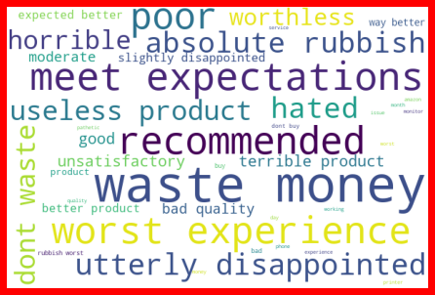
Frequent Words in Shorts Reviews
Frequents words used in ratings 3 and above
Frequents words used in ratings below 3

Slide 13
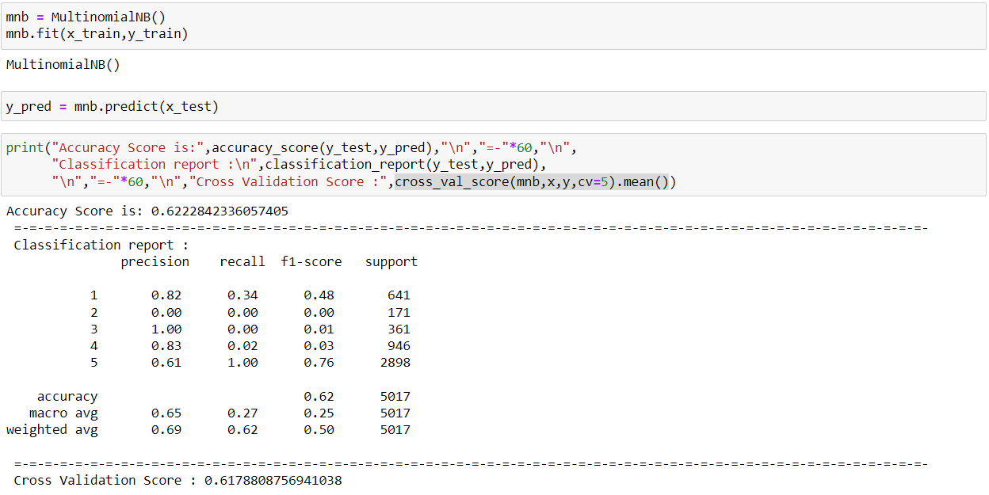
Model selection
MultinomialNB

Slide 14
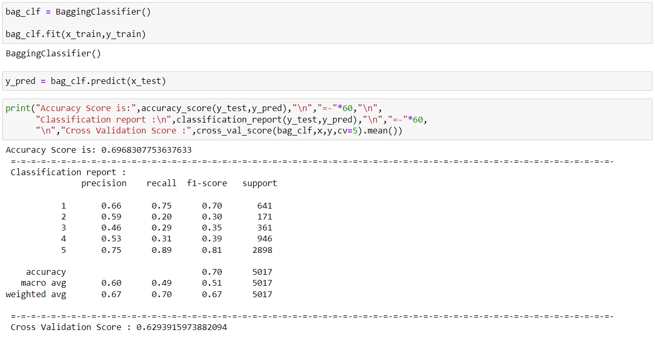
Model selection
Bagging classifier

Slide 15
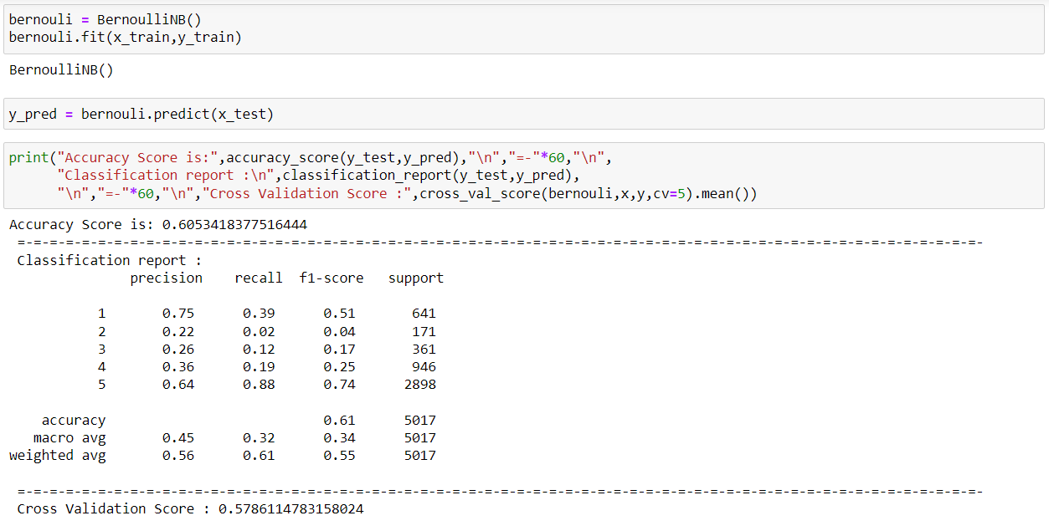
Model selection
Bernouli Regression

Slide 16
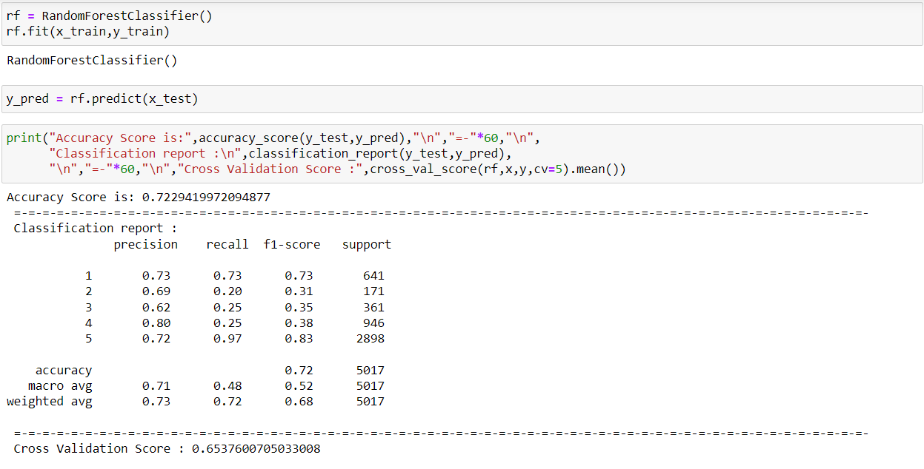
Model selection
RandomForestClassifier

Slide 17
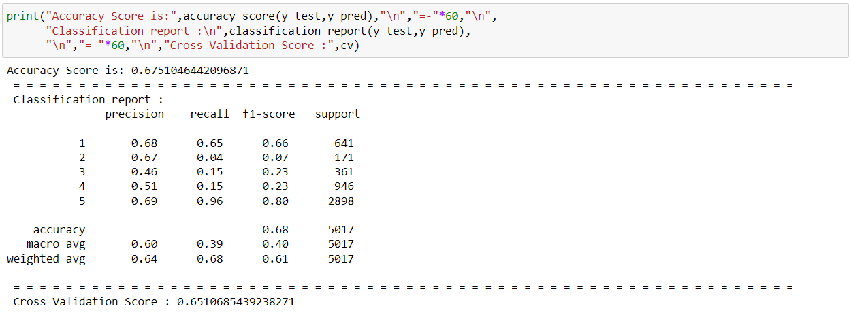
Model selection
CatBoostClassifier

Slide 18

Model selection
SVC Classifier

Slide 19
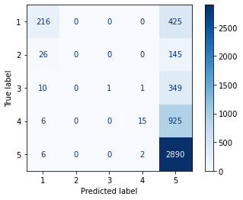
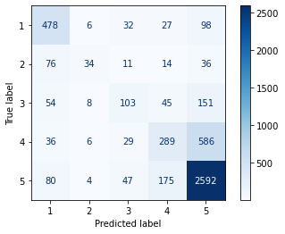
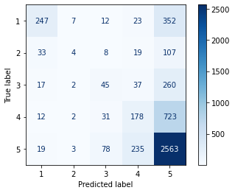
Confusion Matrix
Multinomial Naive Bayes
Bagging Classifier
BernouliNB Classifier

Slide 20
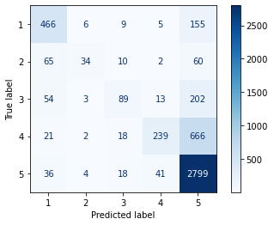
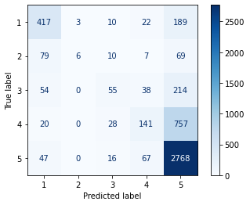
Confusion Matrix
CatBoost Classifier
RandomForest Classifier
SVC Classifier

Slide 21
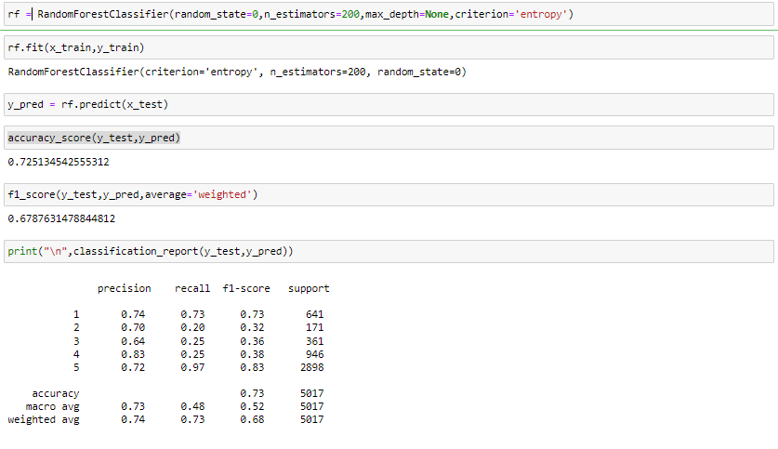
Final Model
RandomForestClassifier(after hyperparameter tuning)

Slide 22
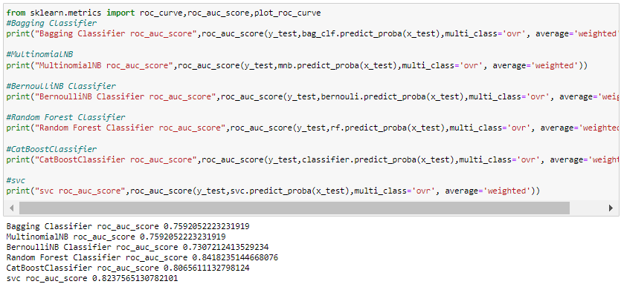
Auc- Roc Score
If we see the Auc-Roc score we can see that Random Forest Classifier covers 84% of the region.

Slide 23
Conclusion
This dataset is imbalanced so I have select the model on the basis of F1_score.
Finally we have build a model which can classify the ratings on the basis of Comments by users.

